Slide 1

SMART INDIA HACKATHON 2026
TITLE PAGE
Problem Statement ID – SIH26145
Problem Statement Title- AI-Based Detection
of Cyber Threats in Unidirectional IP Traffic
Theme- Blockchain and Cybersecurity
PS Category- Software
Team ID-
Team Name – System Hackers

Slide 2
IDEA TITLE
System Hackers
IDEA TITLE:
AI-Powered Real-Time Threat Detection for One-Way Networks
PROBLEM:
Some sensitive networks are intentionally kept one-way for safety.
The monitoring system can receive network information, but cannot send commands back.
An unusual network event may be caused by either a technical problem or a cyberattack.
Traditional security tools may depend on two-way communication for active monitoring, which is restricted in a unidirectional network.
OUR SOLUTION:
Build an AI-based real-time network monitoring system.
Continuously collect the network information visible through the one-way connection.
Learn the normal communication behaviour of the protected network.
Detect unusual behaviour as it happens.
Distinguish between normal activity, technical/network anomalies and possible cyber threats.
Generate alerts with confidence and supporting evidence.
WORKFLOW:
Protected Network -> One-way Network Traffic -> Network Telemetry -> AI/ML Analysis -> Real-Time Anomaly Detection -> Threat Classification -> Evidence + Confidence -> Instant Alert

Slide 3
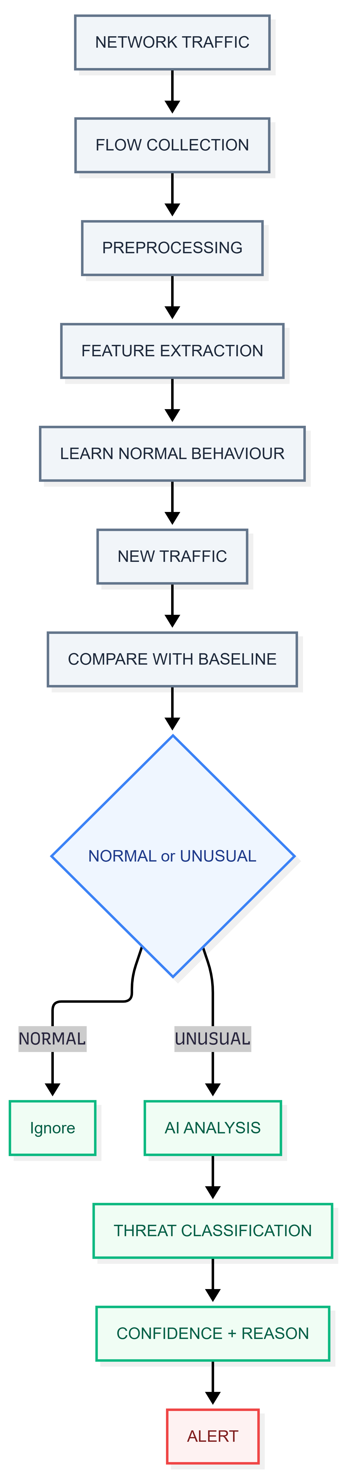
TECHNICAL APPROACH
System Hackers
TECHNOLOGIES USED:
Language:
Python
Machine Learning:
Scikit-learn
XGBoost
Deep Learning:
PyTorch
Data Processing:
Pandas
NumPy
Backend:
FastAPI
Dashboard:
React
Database:
SQL / PostgreSQL
Deployment:
Docker
IMPLEMENTATION PROCESS:

Slide 4
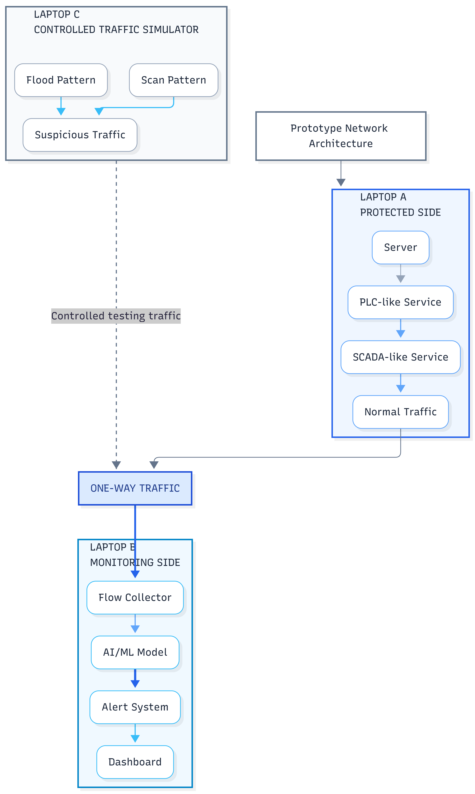
FEASIBILITY AND VIABILITY
System Hackers
FEASIBILITY:
Software-only prototype → Can be developed using laptops/virtual machines without specialized hardware.
Public datasets + controlled simulation → Use existing network-security datasets and safely generate normal, technical, and suspicious traffic for testing.
Modular and practical development → Traffic collection, AI detection, alert system, and dashboard can be developed separately and integrated within the hackathon.
MAIN CHALLENGES:
False alarms → Use normal behaviour baseline + multiple traffic indicators.
Limited attack data → Use public datasets + controlled traffic generation.
Unknown attacks → Keep an anomaly/unknown category instead of forcing a known label.
Real-time processing → Work mainly with lightweight network-flow features.
One-way communication → Monitoring system only observes the incoming traffic and does not send commands to the protected side.
DEMO:

Slide 5
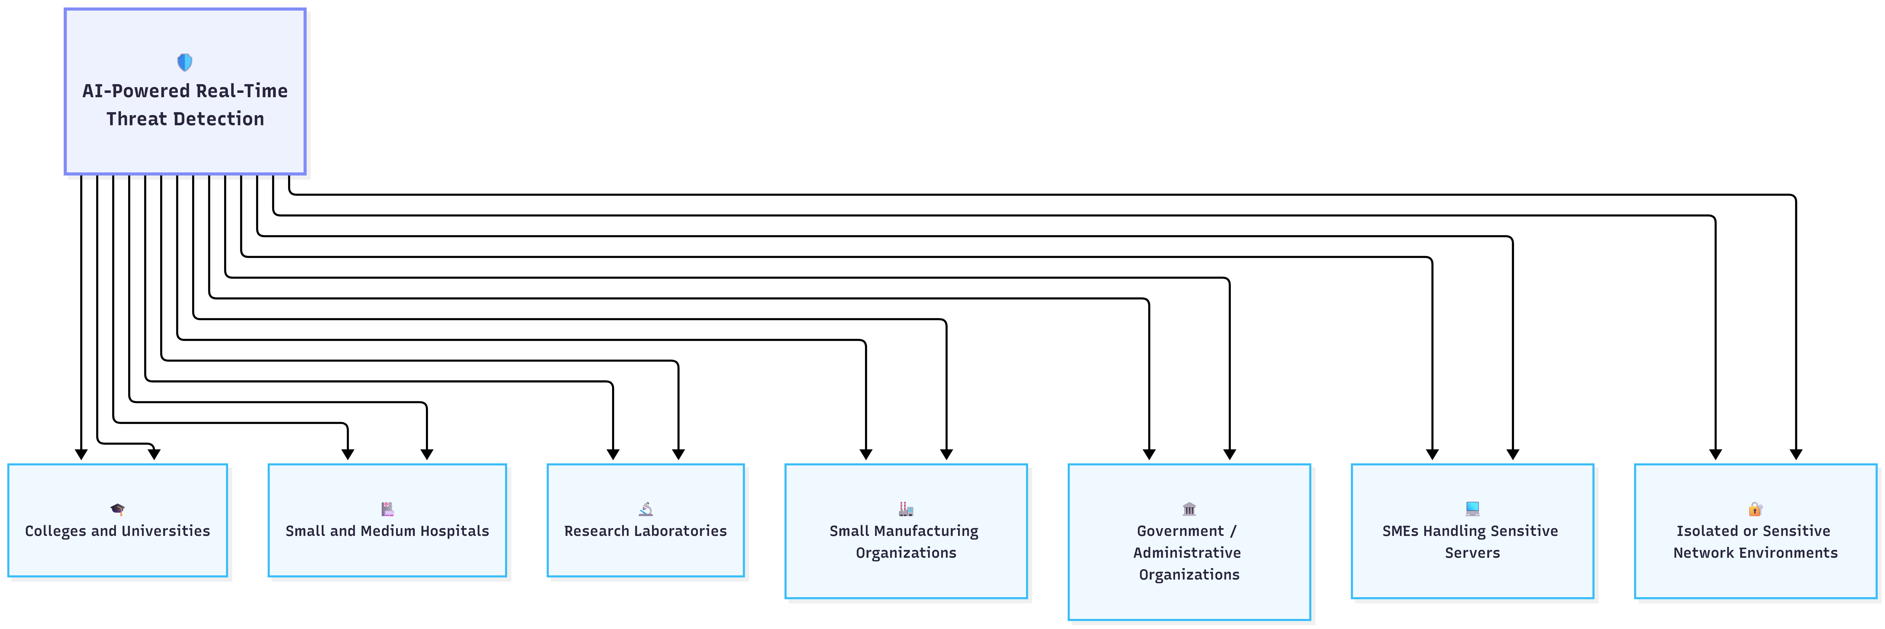
IMPACT AND BENEFITS
System Hackers
IMPACT
Helps detect suspicious network behaviour at an early stage.
Provides continuous monitoring without sending commands to the protected network.
Helps security teams identify whether unusual activity is more likely a technical issue or a cyber threat.
Can provide useful monitoring capability for organizations with limited cybersecurity resources.
Can act as an additional detection layer alongside existing security systems.
BENEFITS:
Detects unusual network behaviour continuously.
Generates alerts while suspicious traffic is occurring.
Works with networks where monitoring is receive-only.
Uses a software-based approach, reducing the need for specialized hardware.
Shows the reason and confidence behind each alert.
Can be extended to larger and more complex networks.

Slide 6
RESEARCH AND REFERENCES
System Hackers
RESEARCH:
Study of AI/ML-based network intrusion detection
Study of anomaly-based network traffic detection
Study of unidirectional networks and data-diode architectures
Study of network-flow-based threat detection
Study of real-time network traffic classification
Analysis of publicly available network intrusion datasets
REFERENCES:
SIH26145 Problem Statement — AI-Based Detection of Cyber Threats in Unidirectional IP Traffic
Research papers on Network Intrusion Detection Systems (NIDS)
Research papers on Anomaly Detection in Network Traffic
Research papers on Unidirectional / One-Way Network Security
Public datasets such as CIC-IDS / CIC-DDoS / UNSW-NB15 for model development and testing
Documentation for the selected Python, ML, networking and dashboard technologies

